Slide 1

How slow load times hurt UX (and what you can do about it)
Tammy Everts O’Reilly Fluent 2016

Slide 2

@tameverts
performancebeacon.com WPOstats.com

Slide 3


Slide 4
What do users want?
What metrics does performance affect?
What are the most common performance issues?
What can you do to fix them?

Slide 5
What do users want?

Slide 6


Slide 7
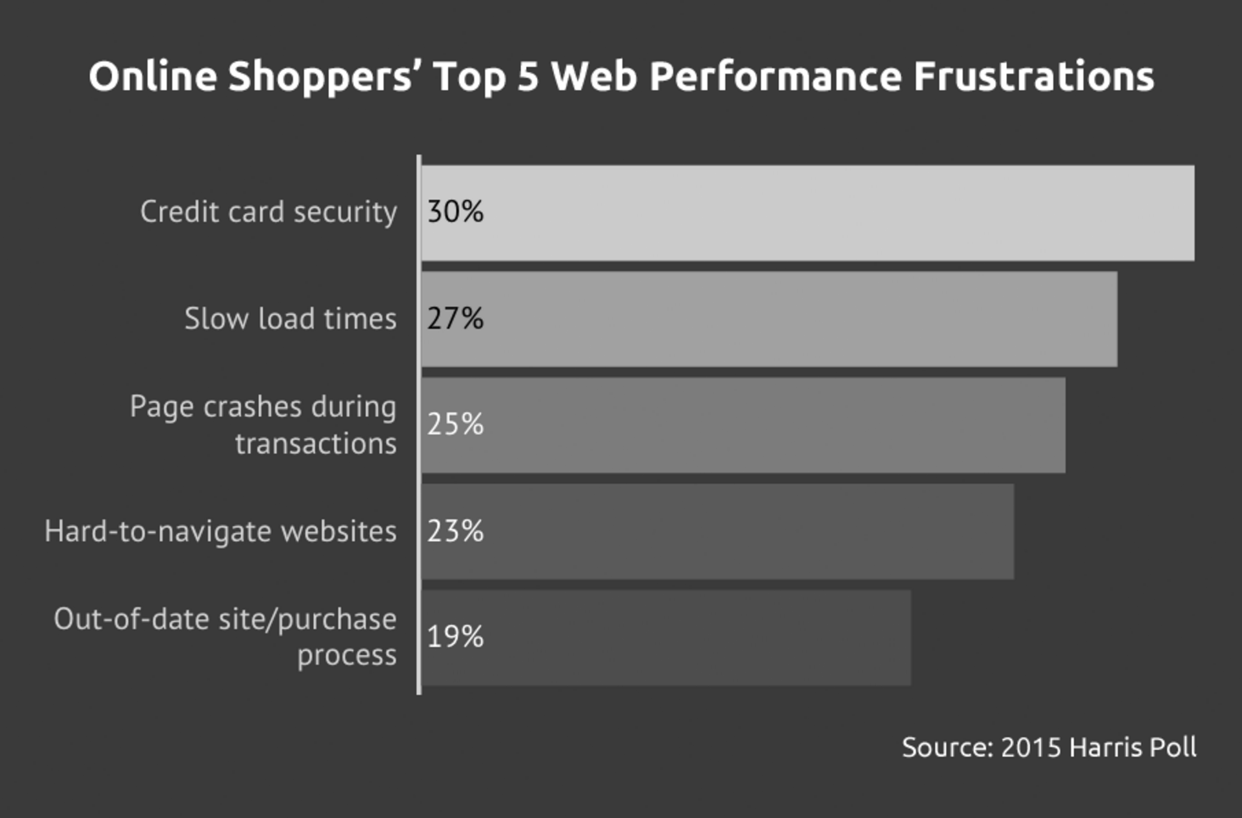

Slide 8

“47% of consumers expect a web page to load in 2 seconds or less.”
Akamai, 2009

Slide 9
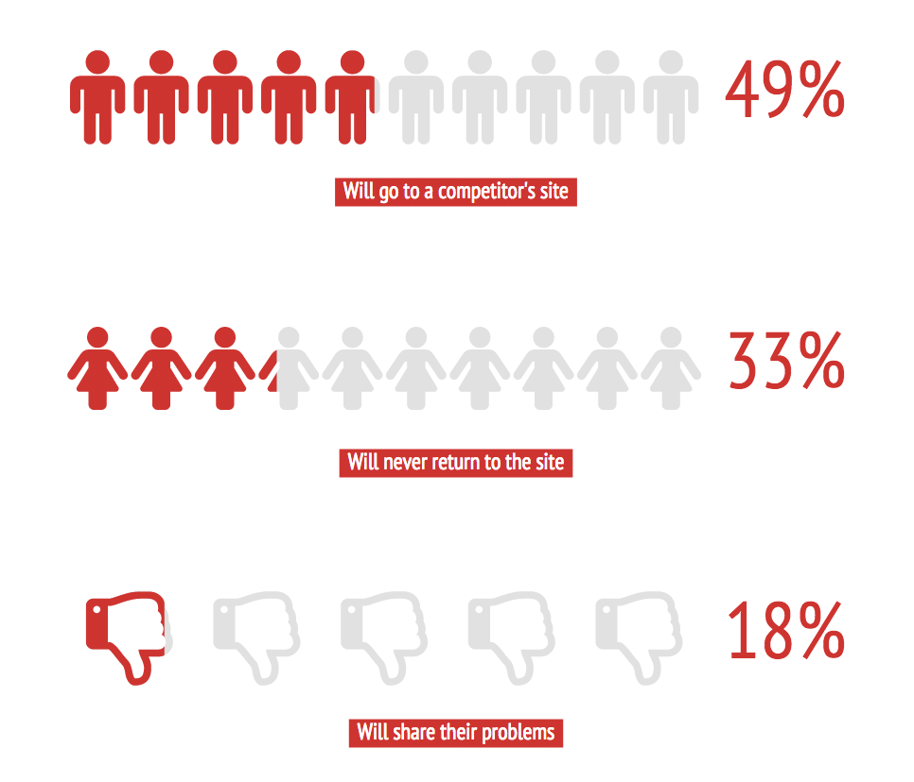

Slide 10
“But my site is different.”

Slide 11
Performance affects everything… for everyone

Slide 12
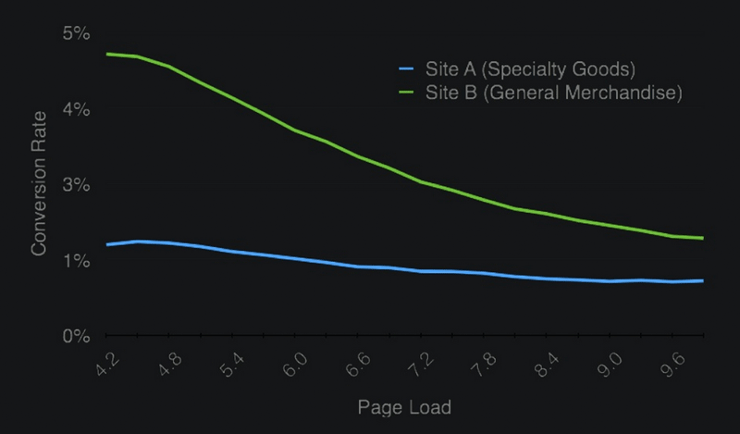

Slide 13



Every 1 second of load time improvement equals a 2% conversion rate increase for Walmart.com
Staples.com shaves 1 second from median load time, improves conversion rate by 10%
Intuit cuts load times by more than half, increases conversions by 14%

Slide 14
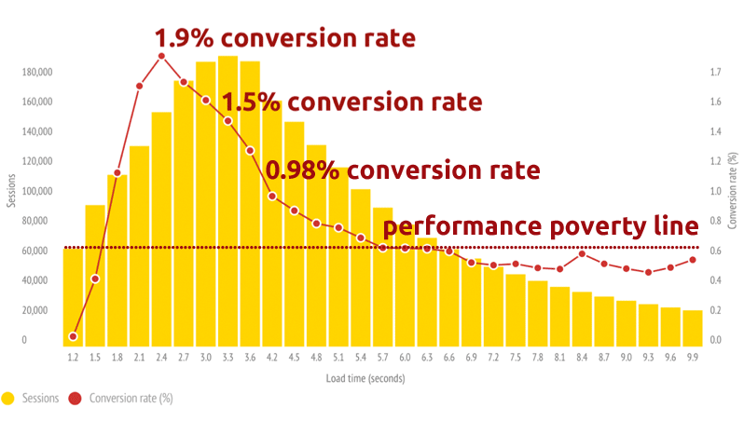
http://www.soasta.com/blog/mobile-web-performance-monitoring-conversion-rate/
http://www.soasta.com/blog/mobile-web-performance-monitoring-conversion-rate/
http://www.soasta.com/blog/mobile-web-performance-monitoring-conversion-rate/
http://www.soasta.com/blog/mobile-web-performance-monitoring-conversion-rate/

Slide 15



At Google, a 500-millisecond slowdown equals a 25% decrease in searches
GQ cuts load time by 80%, grows traffic by 83%
Edmunds.com shaves 7 seconds off load time, sees 17% increase in page views and 3% increase in ad revenue

Slide 16

“We ran this experiment on mobile web where we added 160 kilobytes of hidden images, meaning the user saw nothing different. We just dumped a bunch of hidden images onto the page and increased page weight by 160 kilobytes. It triggered a 12% increase in bounce rate. Insane. Twelve percent is a lot of percent.”
Lara Hogan, Senior Engineering Manager

Slide 17
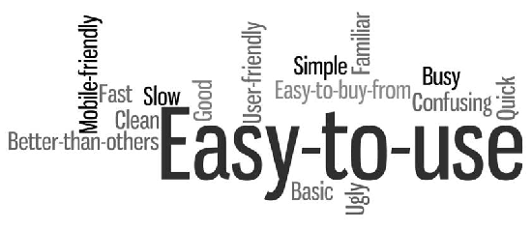
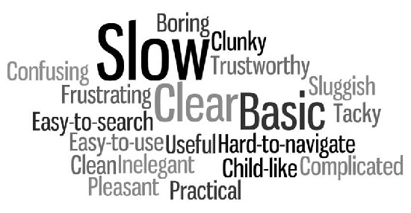
fast
slow

Slide 18
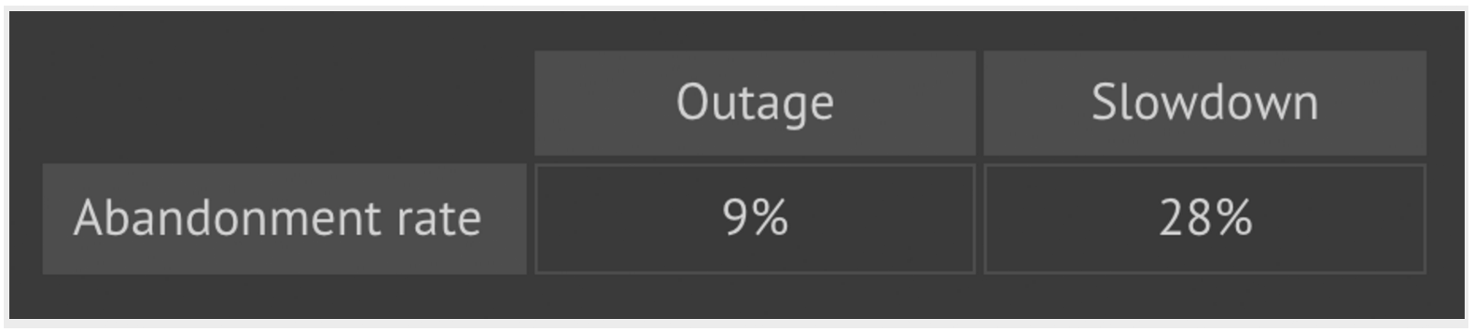

Slide 19
What are the most common performance/UX issues?

Slide 20


Slide 21
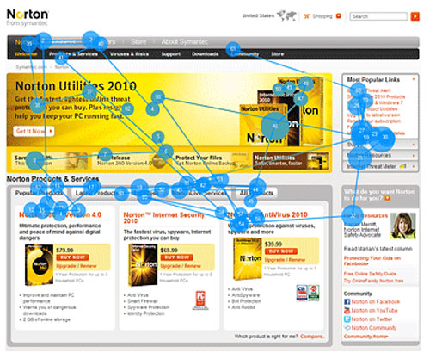

Slide 22
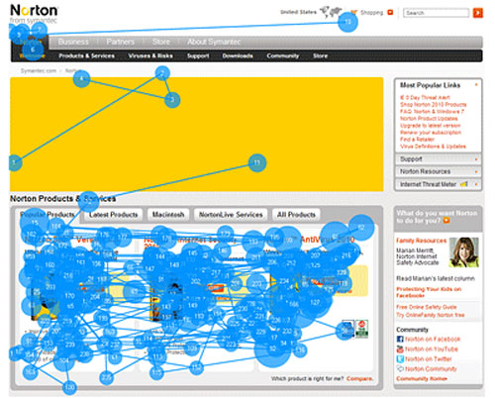

Slide 23
Why?????
Poorly executed stylesheets e.g. carousels, sliders, RWD, custom fonts
Blocking/unoptimized JS e.g. third-party scripts, pop-ups
Massive resources e.g. high-res hero images
Designing, developing, and testing in an ivory tower
Little/no real user monitoring of live sites

Slide 24
19 things you can do*
*There are waaaaay more than 19 things you can do

Slide 25


Slide 26
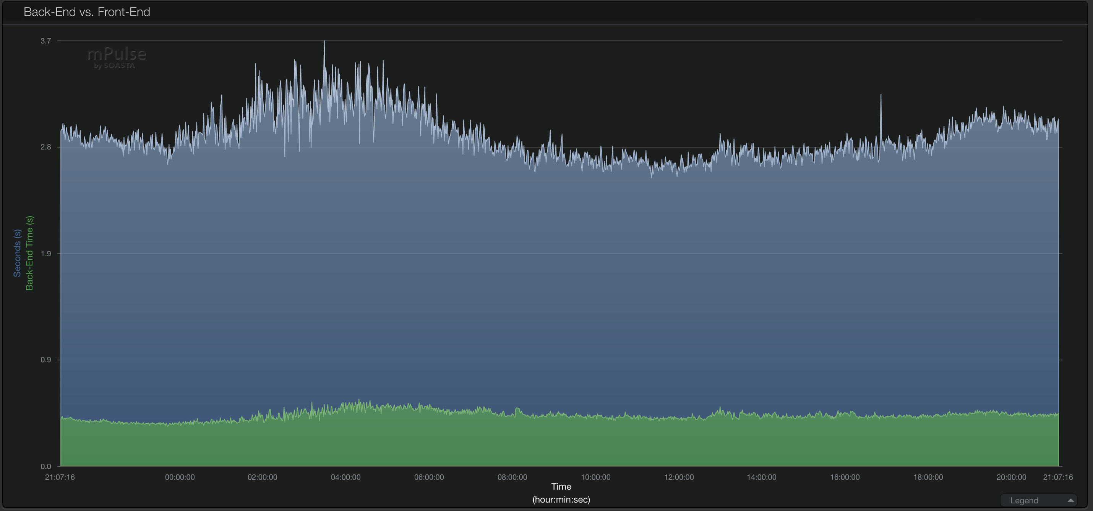
“80-90% of end-user response time is at the front end. Start there.”
Steve Souders, ‘High Performance Web Sites’
Front-end
Back-end

Slide 27
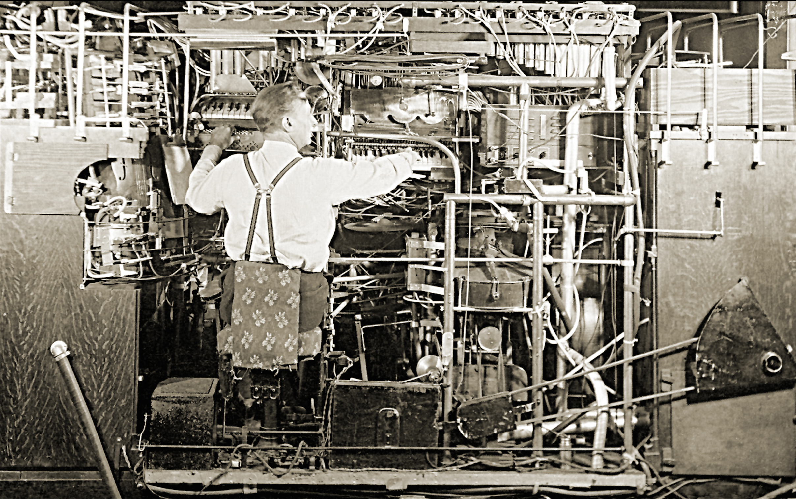

Slide 28
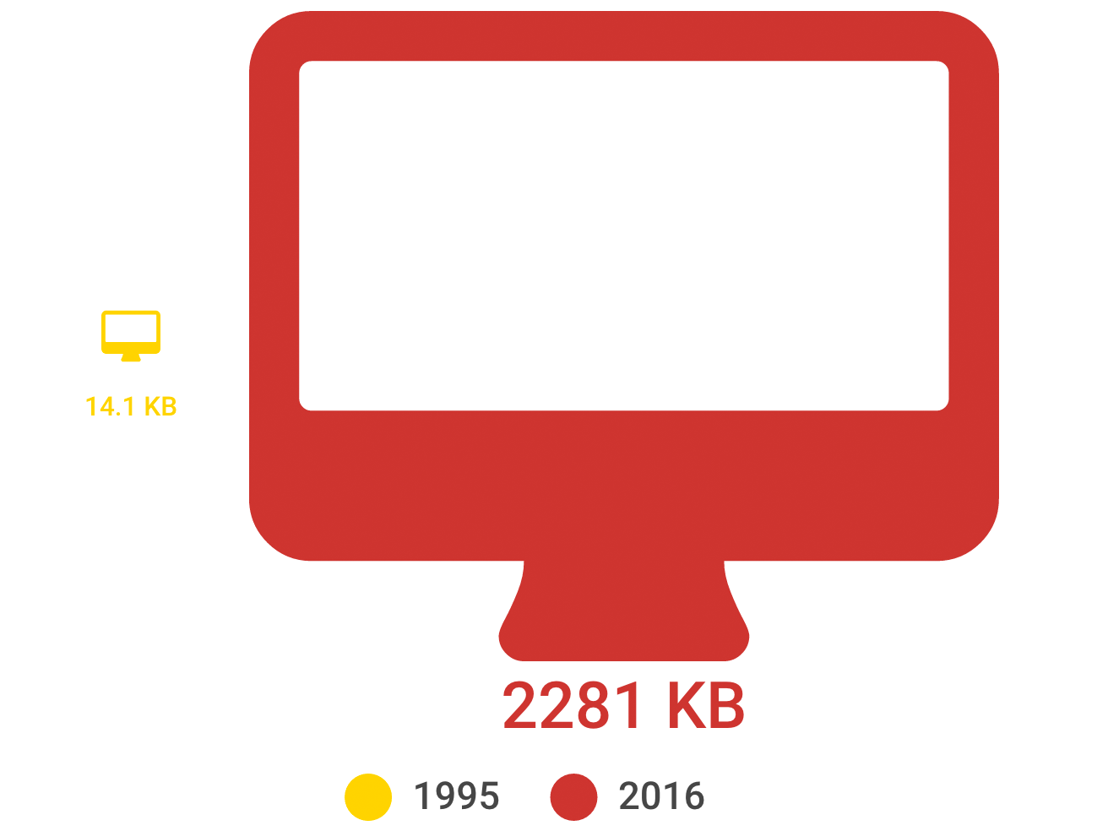

Slide 29
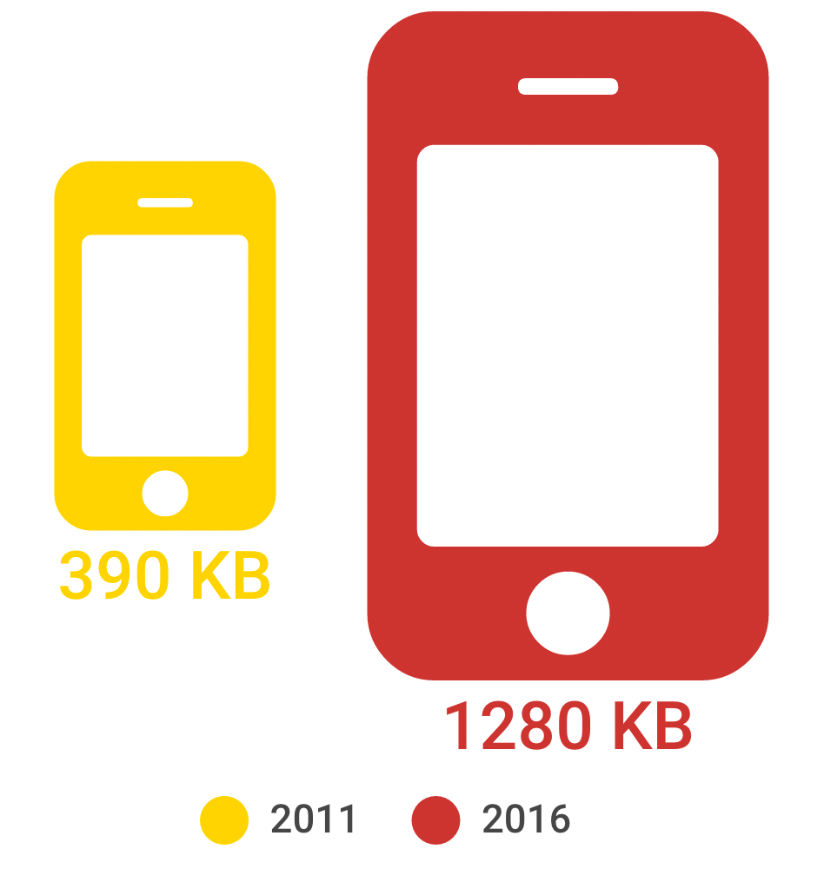

Slide 30
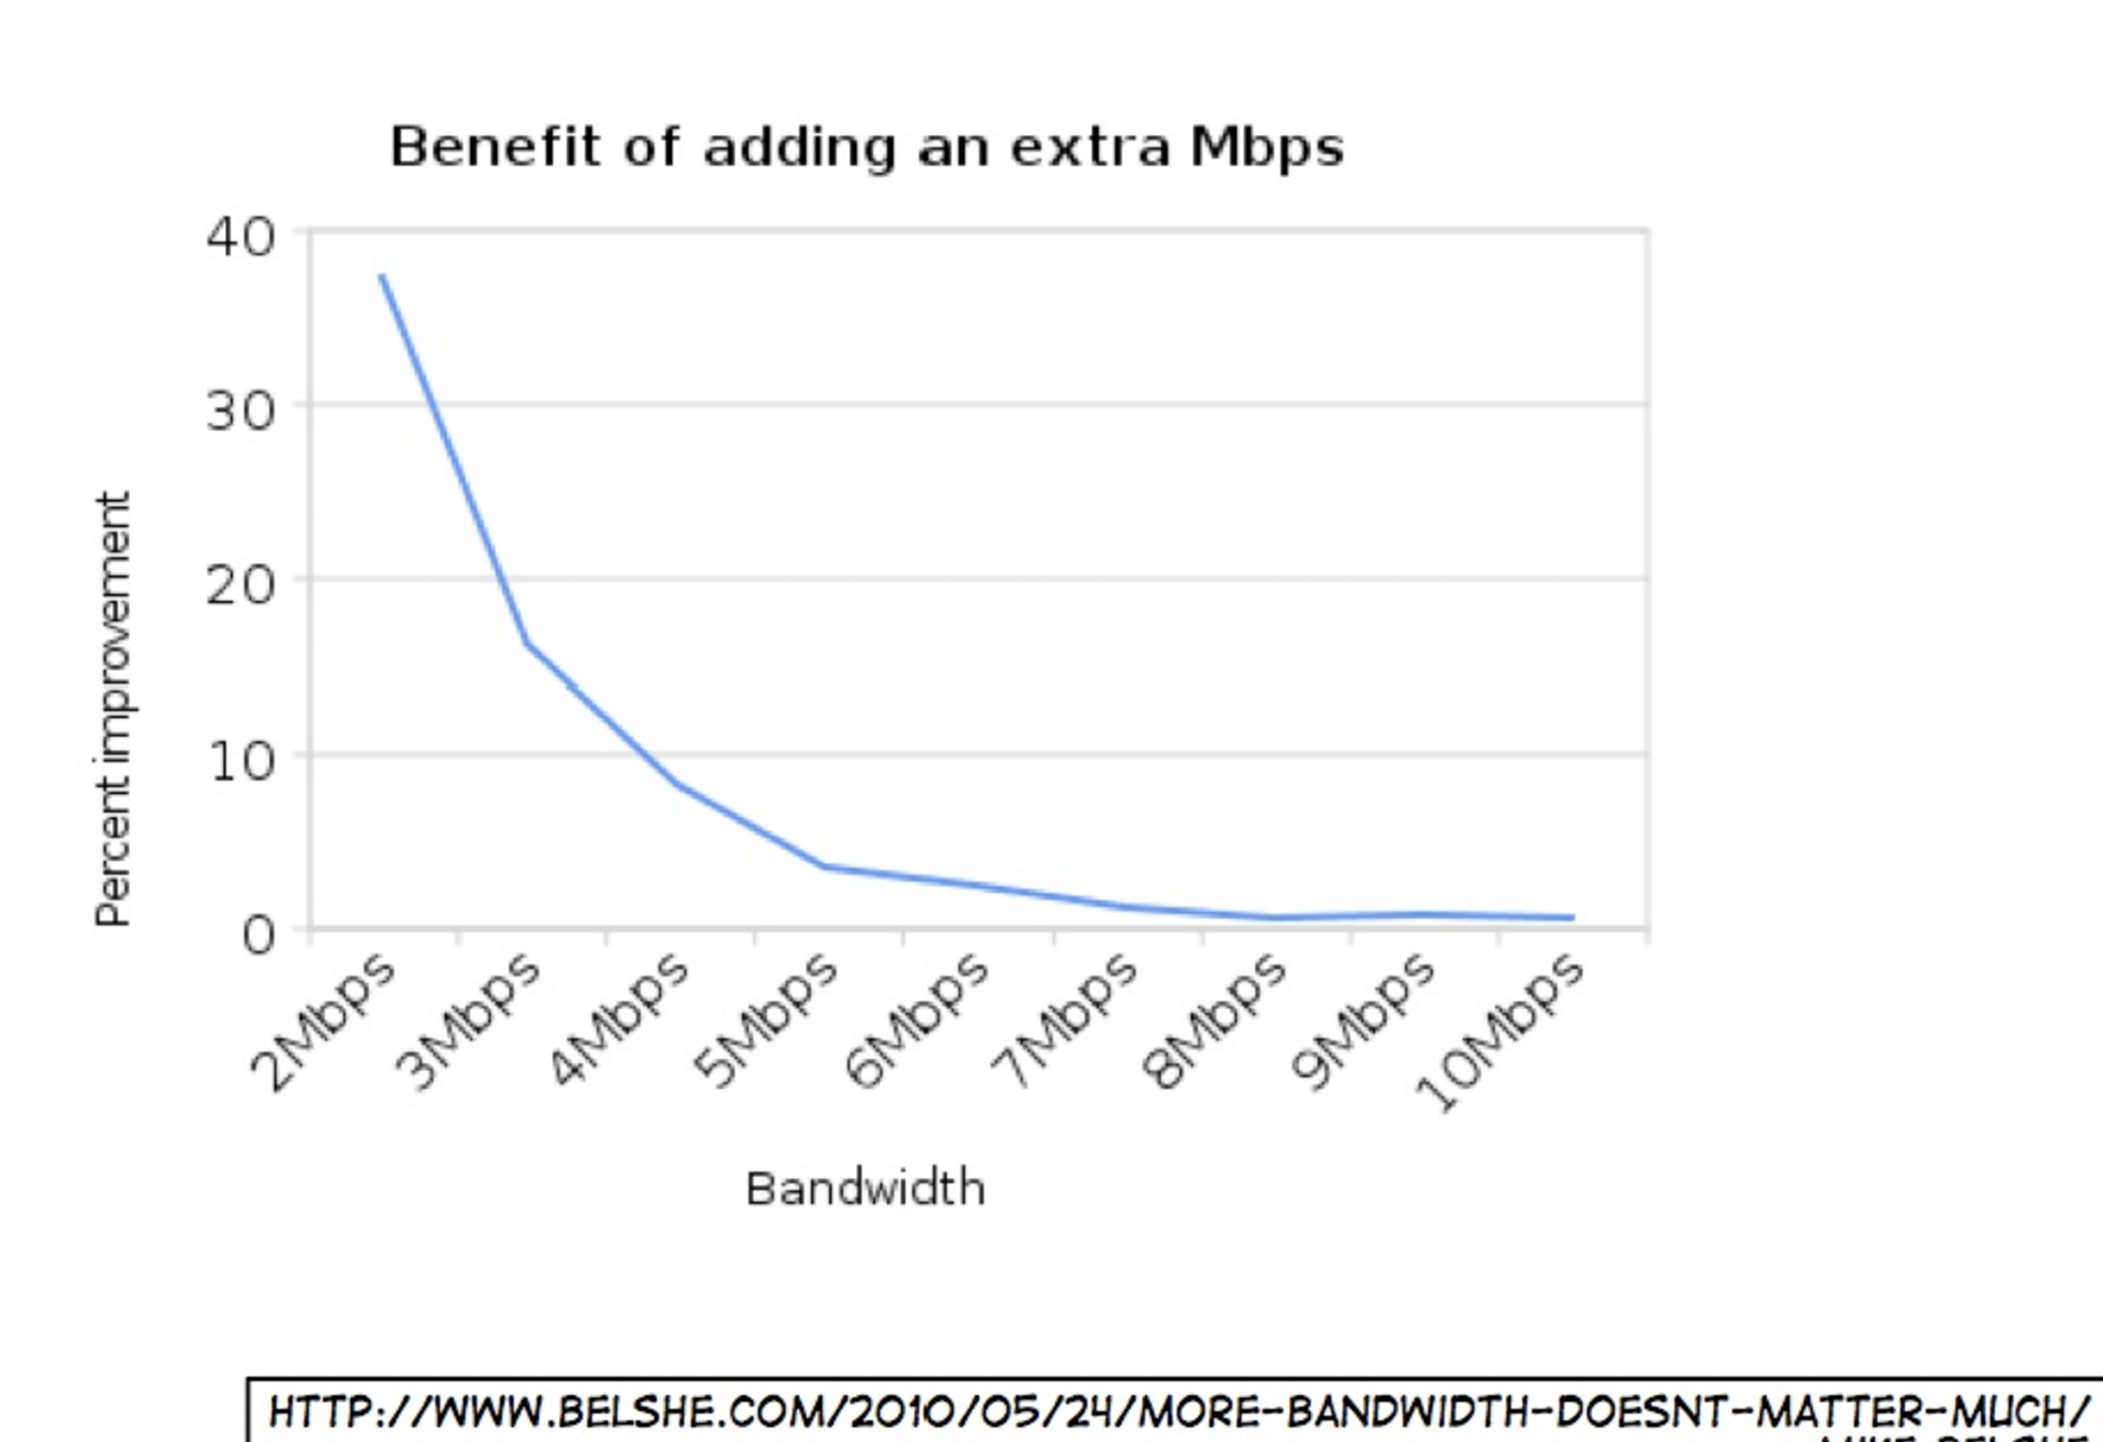

Slide 31
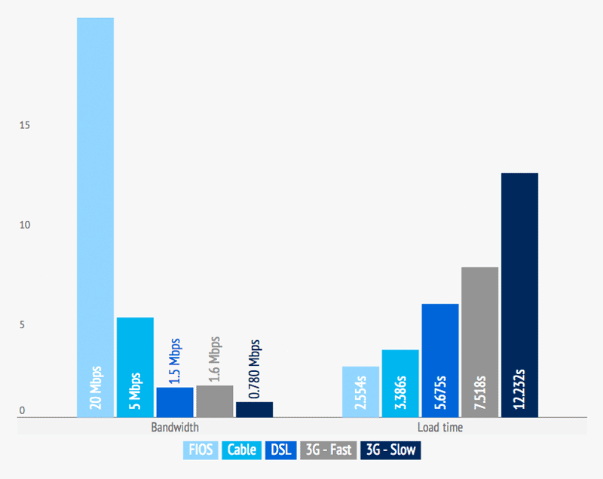
http://www.soasta.com/blog/more-bandwidth-isnt-a-magic-bullet-for-web-performance/

Slide 32
Solutions
Know where your page weight is coming from
Create a performance budget for your pages
Measure, measure, measure

Slide 33


Slide 34
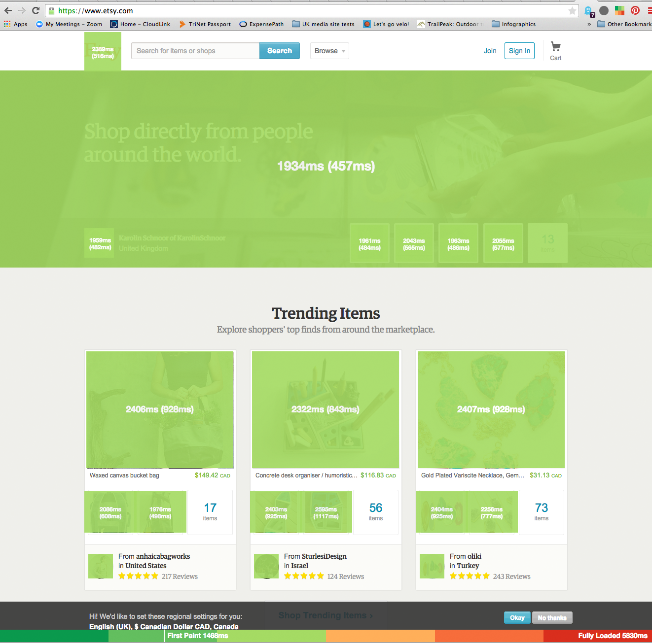

Slide 35
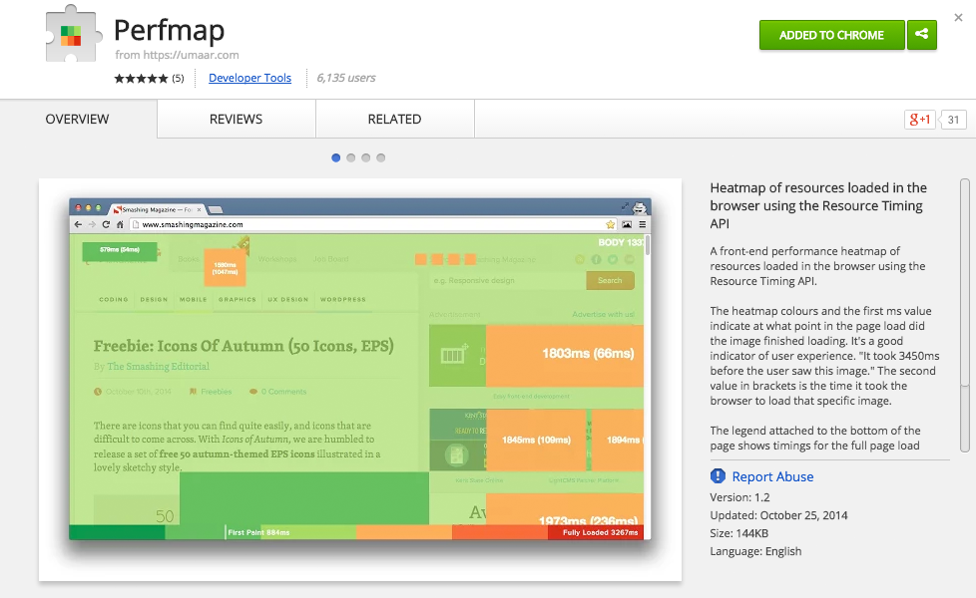

Slide 36

How to set a performance budget
http://timkadlec.com/2013/01/setting-a-performance-budget/
Performance budget metrics
http://timkadlec.com/2014/11/performance-budget-metrics/

Slide 37
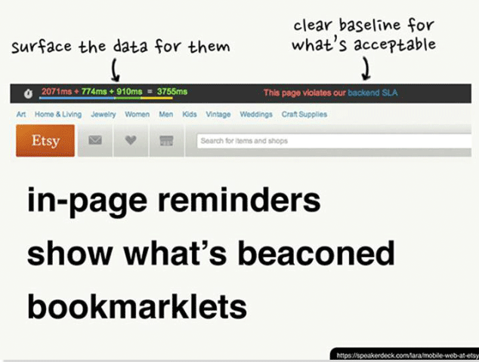

Slide 38
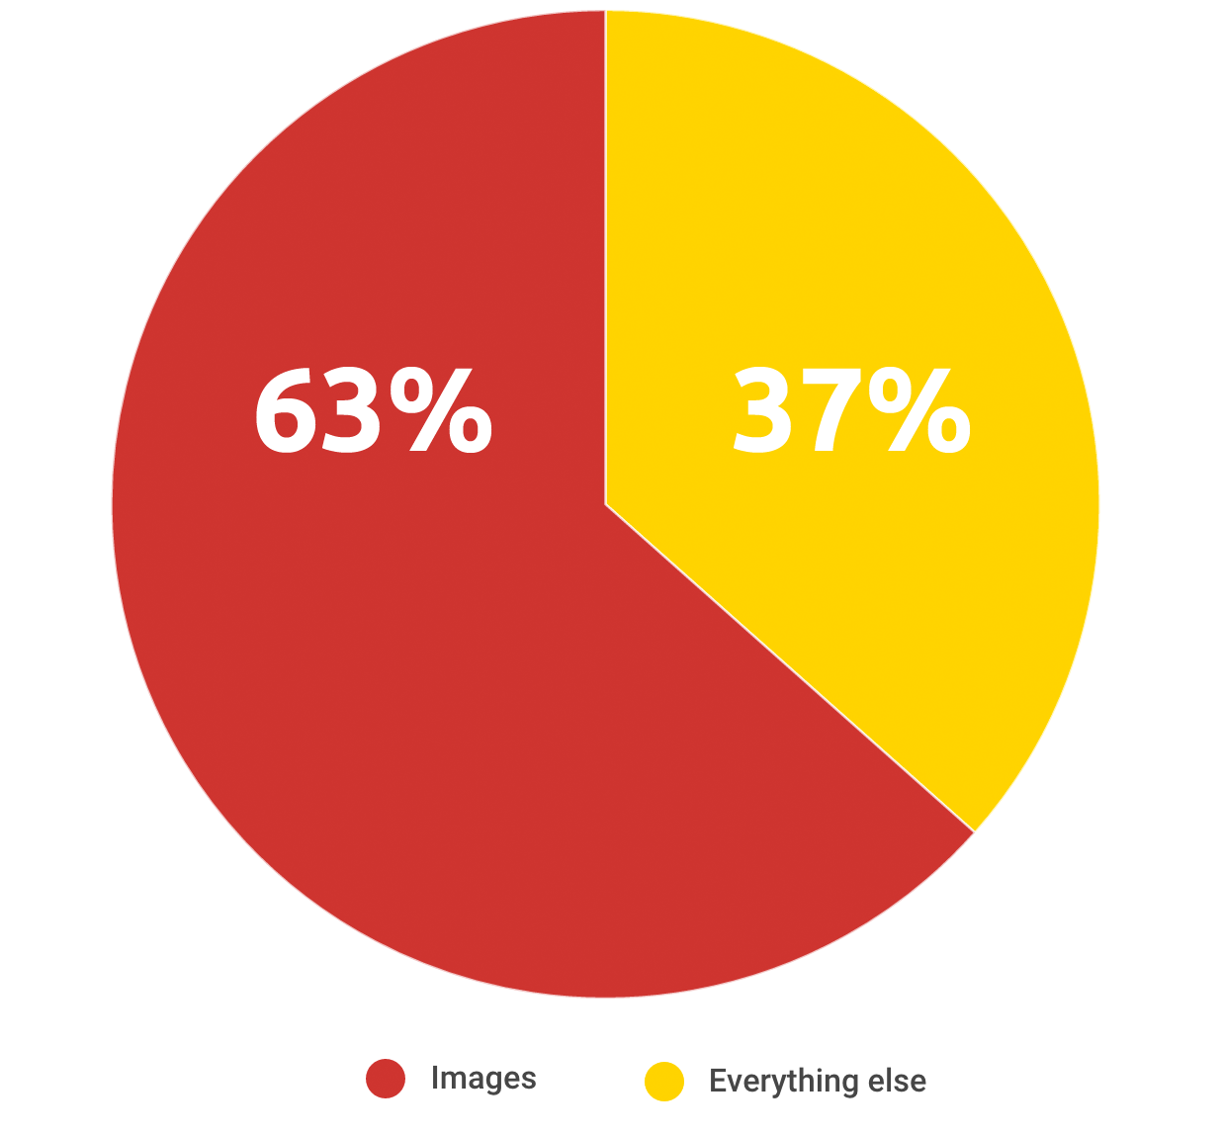

Slide 39
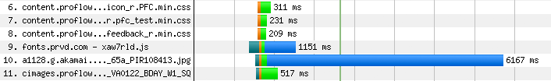

Slide 40
Solutions
Reformat
Compress
Defer/lazy load
Adaptive images
Auto-preloading

Slide 41
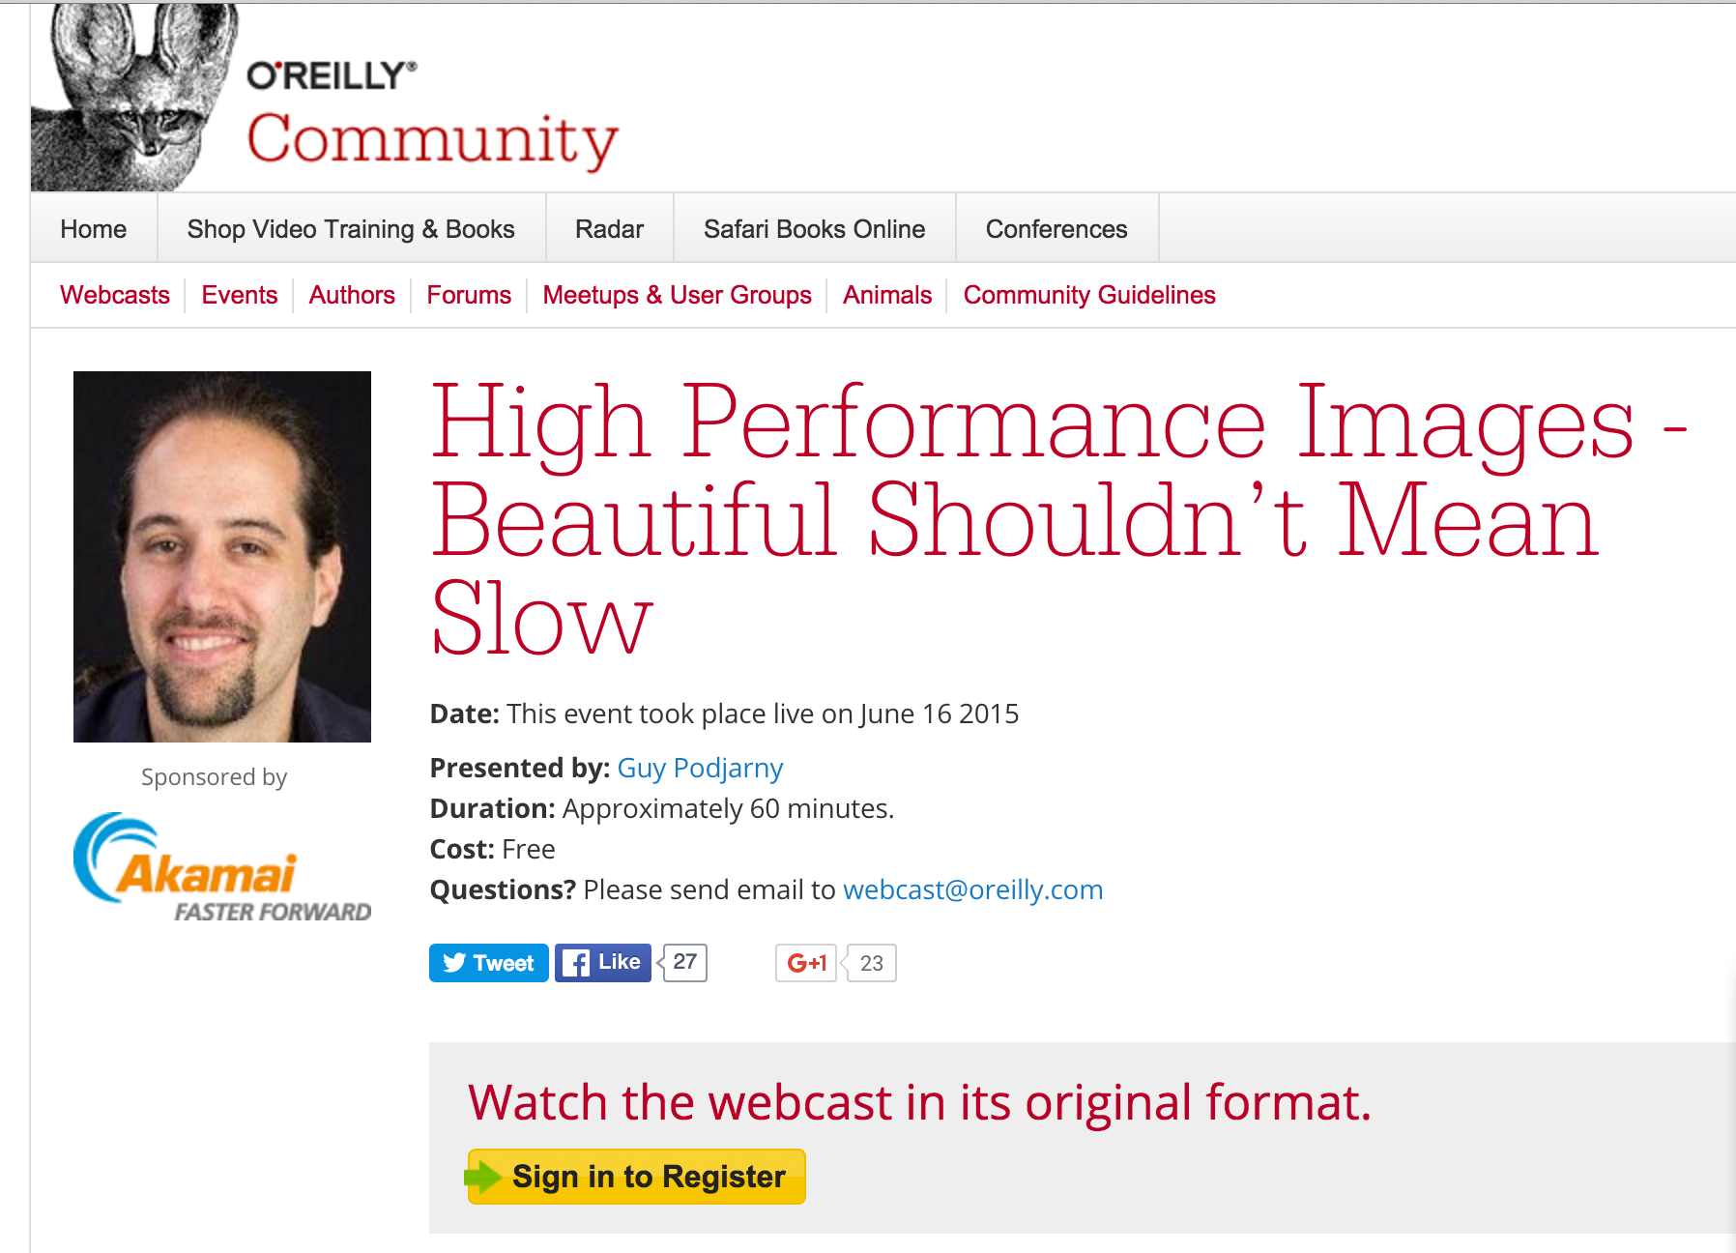
http://www.oreilly.com/pub/e/3425

Slide 42
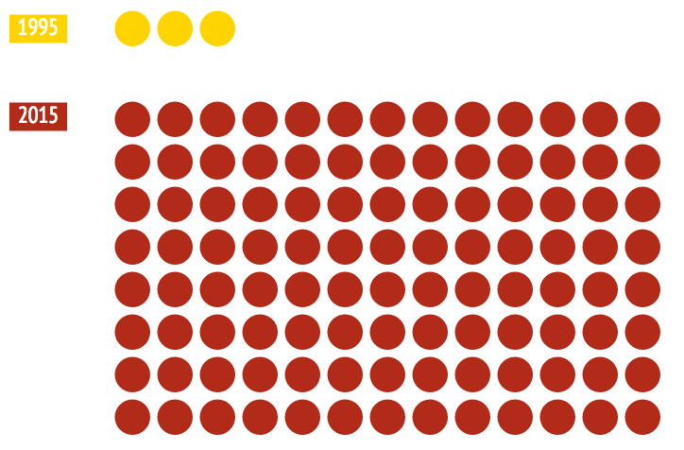
Let’s talk complexity

Slide 43
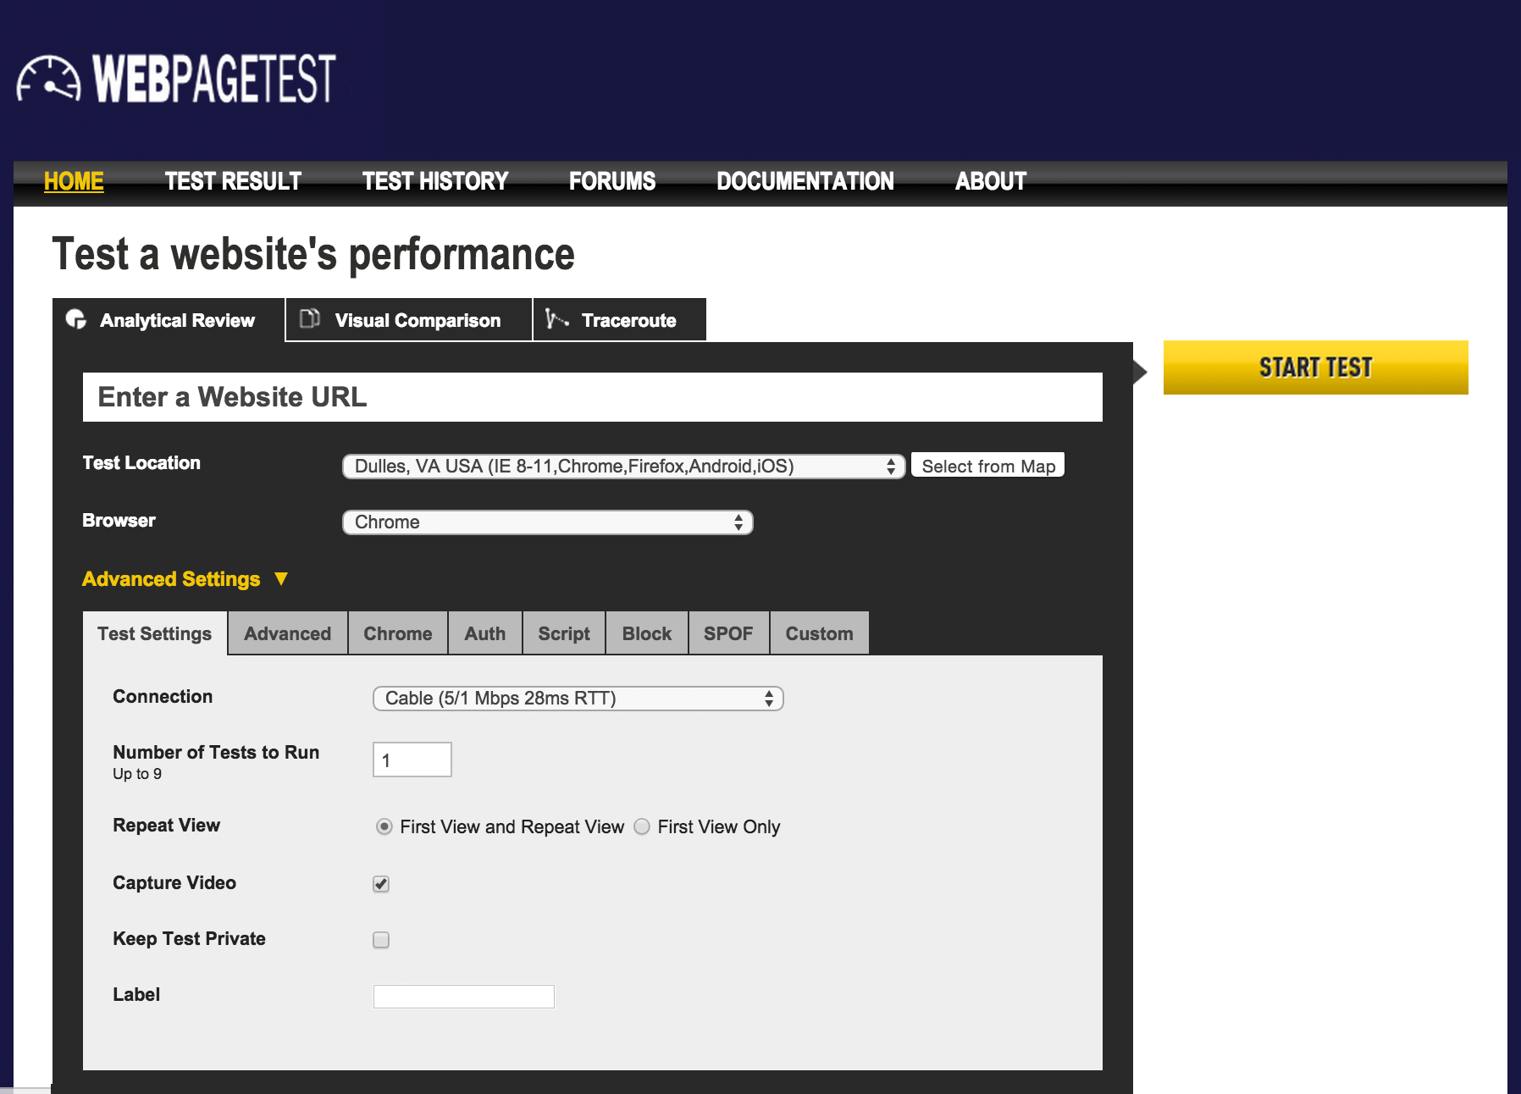
http://www.webpagetest.org/

Slide 44
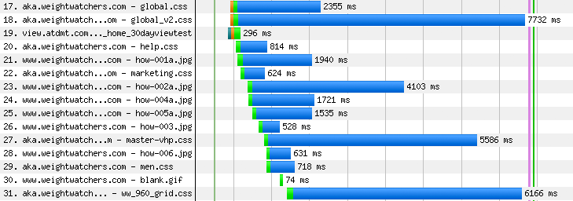

Slide 46
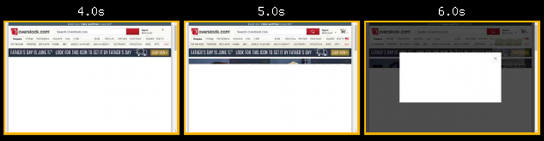

Slide 47
Solutions
Consolidate resources
Make sure stylesheets are in the document HEAD
Optimize web fonts (See Ilya Grigorik’s post: http://soasta.io/1R8ySpw)
Optimize pop-up scripts
Monitor performance ALL THE TIME

Slide 48

http://www.slideshare.net/nzakas/enough-withthejavascriptalready
https://vimeo.com/79098392

Slide 49
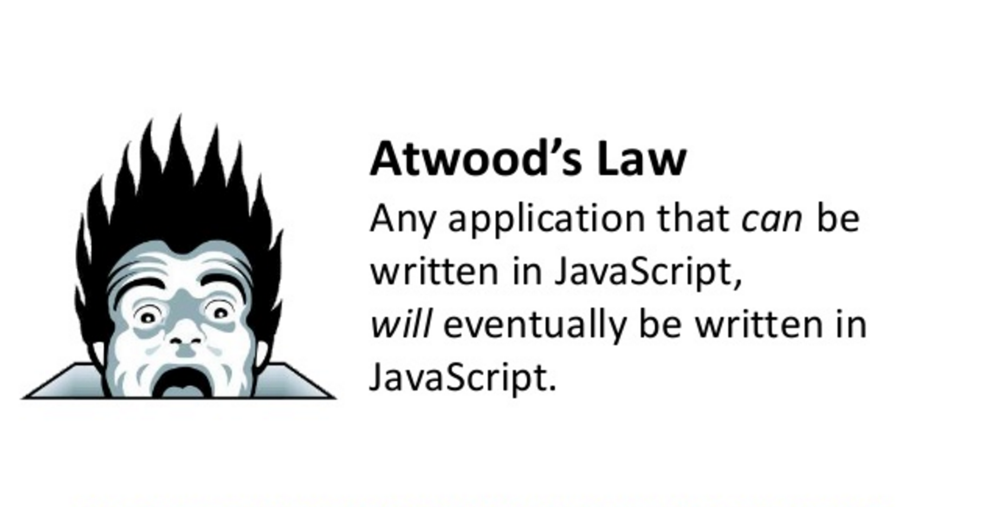
http://blog.codinghorror.com/the-principle-of-least-power/

Slide 50

Third-party content can make up >50% of page requests

Slide 51
What if my third parties fail?
Original: 3.5s
SPOF: 22.7s

Slide 52
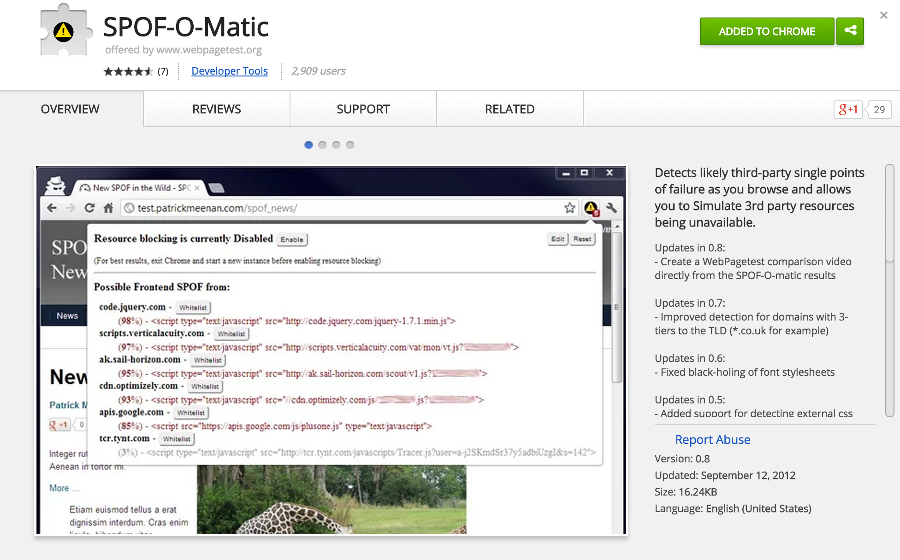

Slide 53
Solutions
Defer scripts
Use asynchronous versions (when possible)
Know your scripts and their performance penalties
Monitor constantly

Slide 54
Keep on learnin’!

Slide 55


Slide 56


Slide 57


Slide 58

http://soasta.io/timeismoneybook

Slide 59
Thanks!
@tameverts
performancebeacon.com WPOstats.com

